Slide 1

BERT: Pre-training of Deep Bidirectional Transformers for Language Understanding
GROUP - 8
Most. Mahjabin, 17101187
Tanzim Ahmed, 20166006
Tamanna Kaiser, 18201137
Rafa Siddiqua, 17301040
Md. Main Uddin Hasan, 17301080
Rakeen Ashraf Chowdhury, 16141014
Majwega Jackson, 20266030
Shegufta Mehzabiin, 20166053

Slide 2
Table of content
Abstract
Related Work
BERT
Architecture
Experiment
Result analysis
Conclusion
References

Slide 3
Abstract
BERT is designed to build a pre-train deep bidirectional representations from unlabeled text.
This model can be adapted to various NLP tasks easily , that’s why re-train a model every time from scratch won’t be necessary.
Unsupervised Feature-based Approaches
Unsupervised Fine-tuning Approaches
Transfer Learning from Supervised Data
Related Work

Slide 4
BERT
In contrast of traditional language model, BERT trains a language model that takes both the previous and next tokens into account when predicting.
BERT is also trained on a next sentence prediction task
BERT uses the Transformer architecture for encoding sentences.
BERT performs better when given more parameters, even on small datasets.

Slide 5
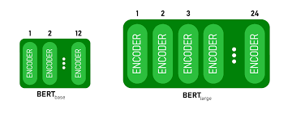
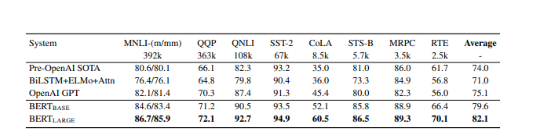
Architecture
BERT Base
BERT Large
Semi Supervised Learning
ELMo Word Embeddings
ULM-Fit: Transfer Learning In NLP
Open AI Transformer: Pre-training
Experiment
GLUE
SQuAD v1.1 Dataset
SWAG

Slide 6
Result Analysis
Author evaluate on 11 different task where they outperformed those task in terms of language understanding, linguistic acceptability and so on those task are:
Sequence Label Task
MNLI
Squad model task

Slide 7
Conclusion
Author have done a lot of studies where it shows that due to the fact that BERT do this left and right context of a given token when doing the attention that’s why BERTs outperformed maximum models.

Slide 8
References
https://www.aclweb.org/anthology/N19-1423.pdf
Alan Akbik, Duncan Blythe, and Roland Vollgraf. 2018. Contextual string embeddings for sequence labeling. In Proceedings of the 27th International Conference on Computational Linguistics, pages 1638–1649.
Rami Al-Rfou, Dokook Choe, Noah Constant, Mandy Guo, and Llion Jones. 2018. Character-level language modeling with deeper self attention.

